Slide 1
Latin America 102 Quiz

Slide 2
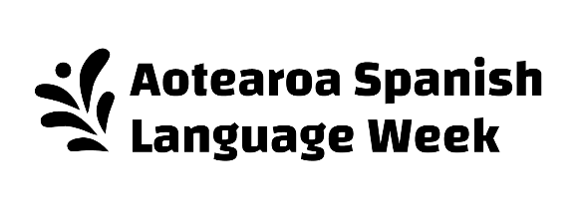
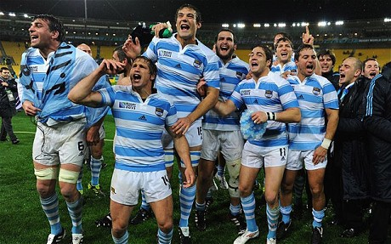
LatAm102 Question one The All Blacks first played the Argentinian rugby team in 1976 – what are they called?

Slide 3
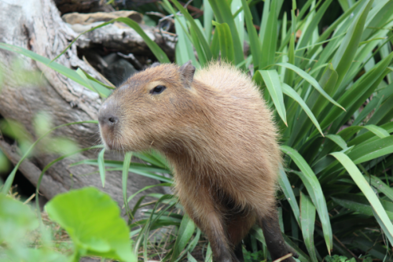
LatAm102 Question two What is the name of this Latin American animal? There is one at the Wellington Zoo!

Slide 4
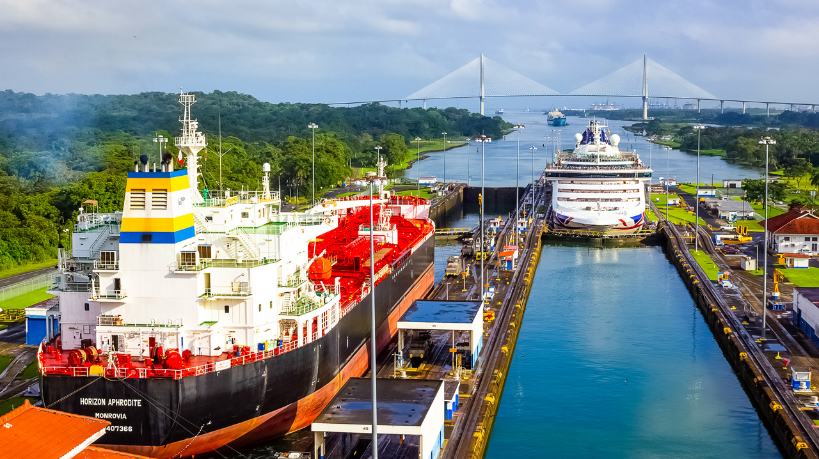
LatAm102 Question three In 2019, Kiwi exporters did NZ$1.22 billion worth of business in Latin America. Our main exports to the region are ___________ products

Slide 5
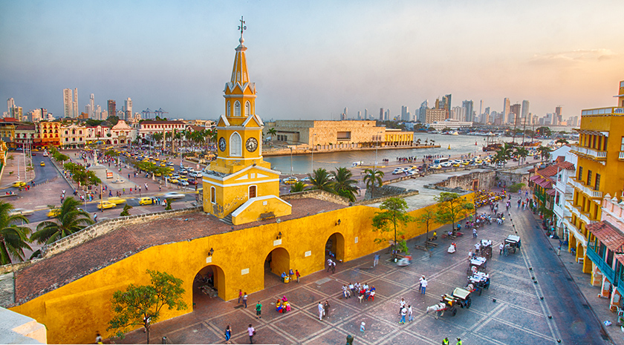
LatAm102 Question four Which Latin American country is the world’s biggest producer of emeralds?

Slide 6
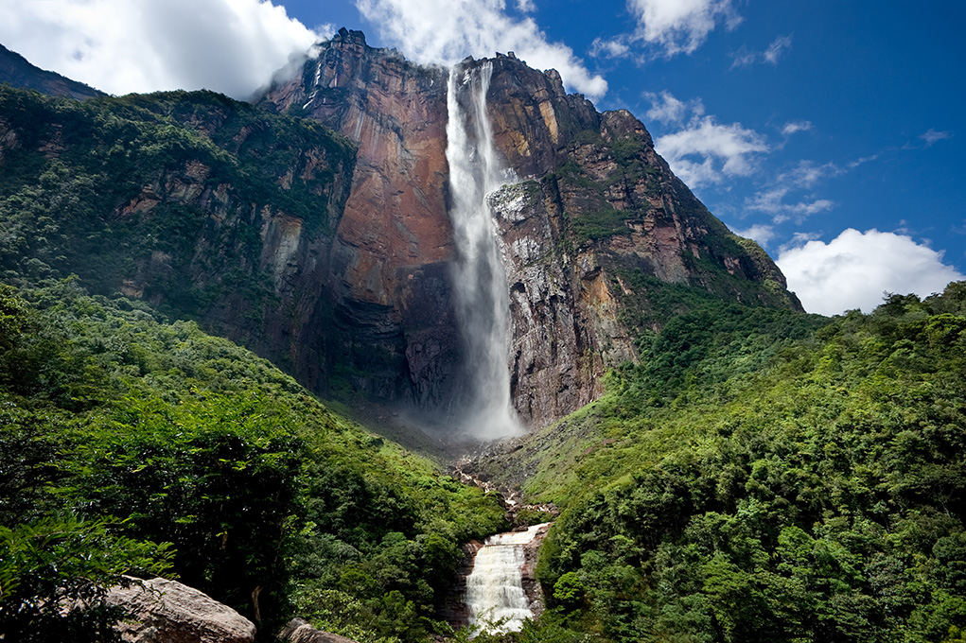
LatAm102 Question five Which Latin American country has the largest oil reserves of any country in the world?

Slide 7
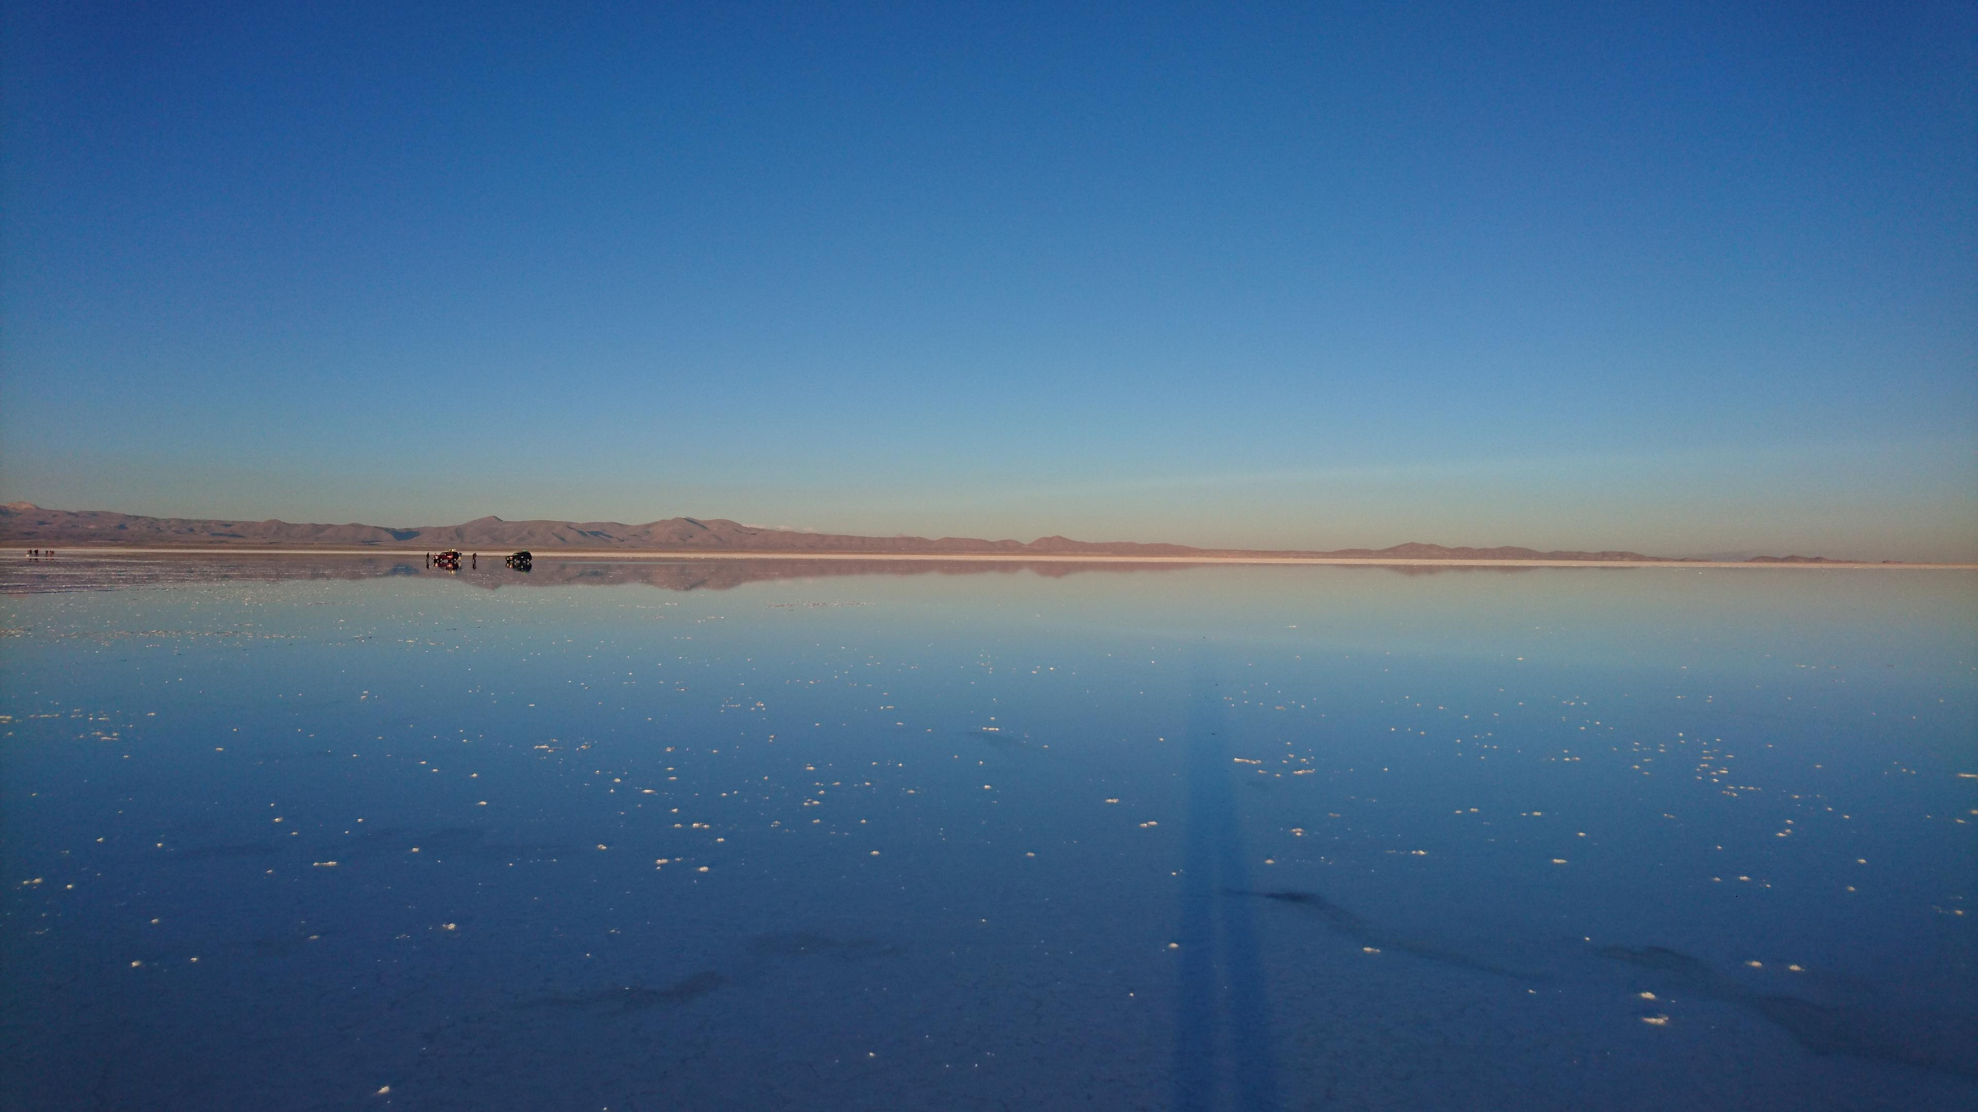
LatAm102 Question six Covering over 10,000 square kilometres across the country of ____________, the Salar de Uyuni is the world's largest mirror!

Slide 8
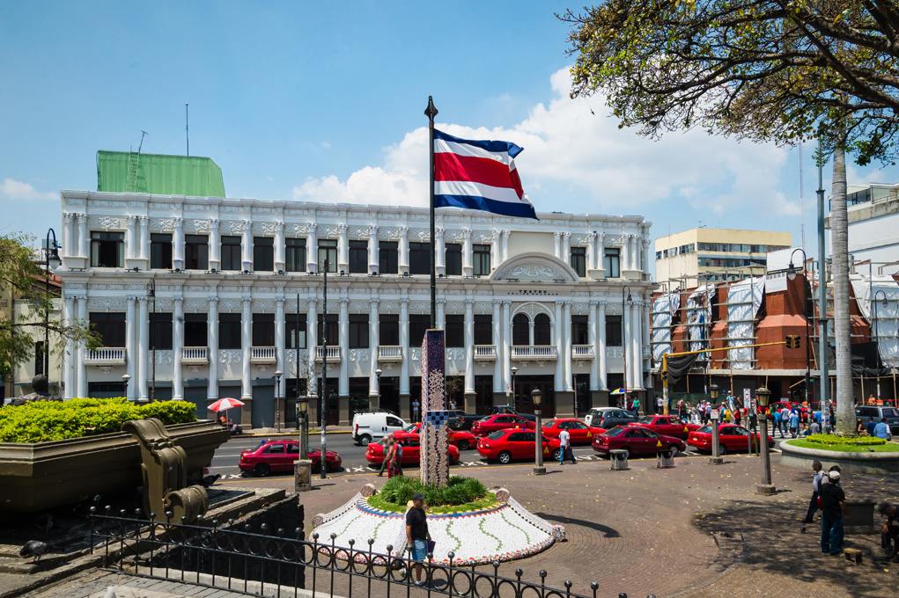
LatAm102 Question seven Which is the only Latin American country to have no permanent standing army?

Slide 9
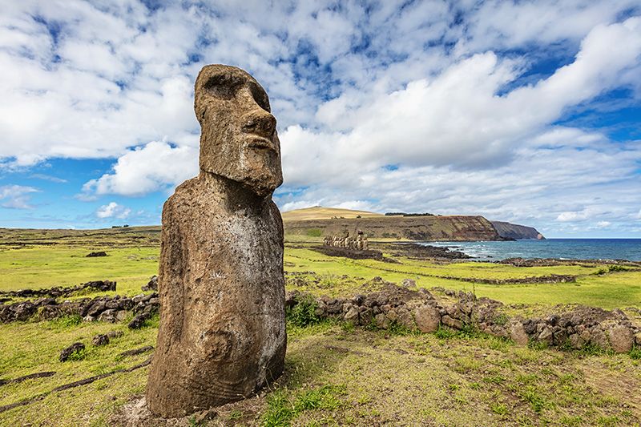
LatAm102 Question eight Easter Island / Isla de Pascua is called what by its indigenous population?

Slide 10
LatAm102 Question nine Which Latin American country won the first ever FIFA World Cup?

Slide 11
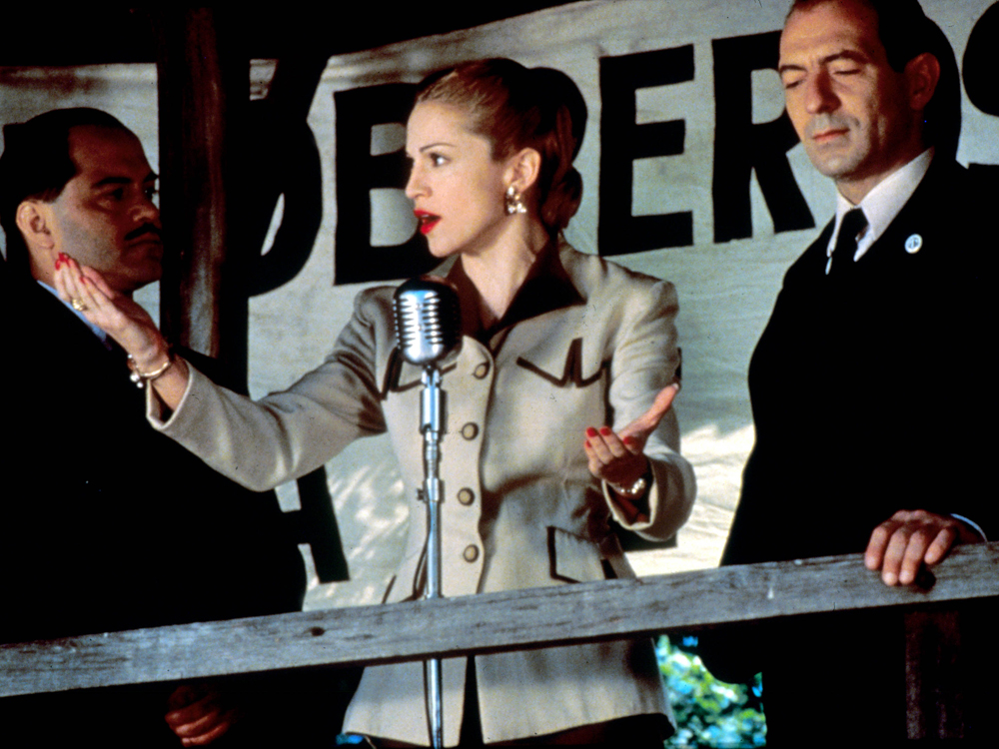
LatAm102 Question ten The musical and movie Evita, is about the first lady of which Latin American country in the 1940s?

Slide 12
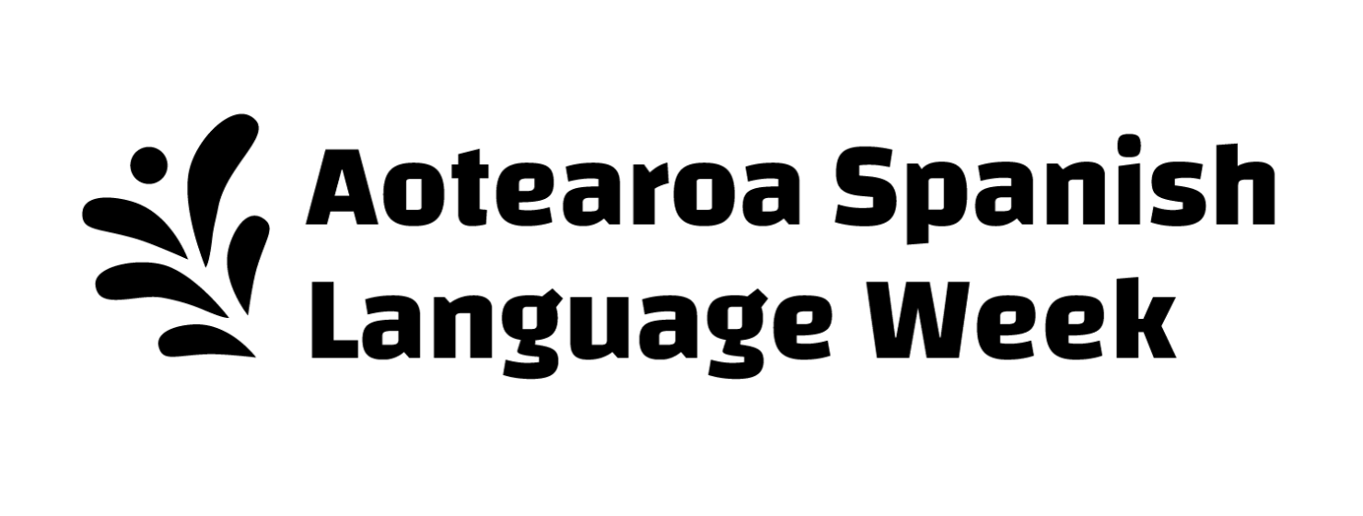
Answers
Los Pumas / The Pumas
Capybara
Dairy
Colombia
Venezuela
Bolivia
Costa Rica
Rapa Nui
Uruguay
Argentina
www.cape.org.nz/nz-spanish-week

