Slide 1
EATING FOR TOMORROW:
FOOD & CLIMATE CHANGE IN CHILE AND AOTEAROA/NEW ZEALAND
ALIMENTÁNDOSE PARA UN BUEN MAÑANA:
NUESTRA COMIDA Y EL CAMBIO CLIMÁTICO EN CHILE Y AOTEAROA/NEW ZEALAND
DECEMBER 2021
Notes:
Kia ora every one, buenas tardes a todos!
We are very excited to share our project with you today, where we delved into the relationship between food and climate change.
Bur first, let us introduce ourselves:

Slide 2
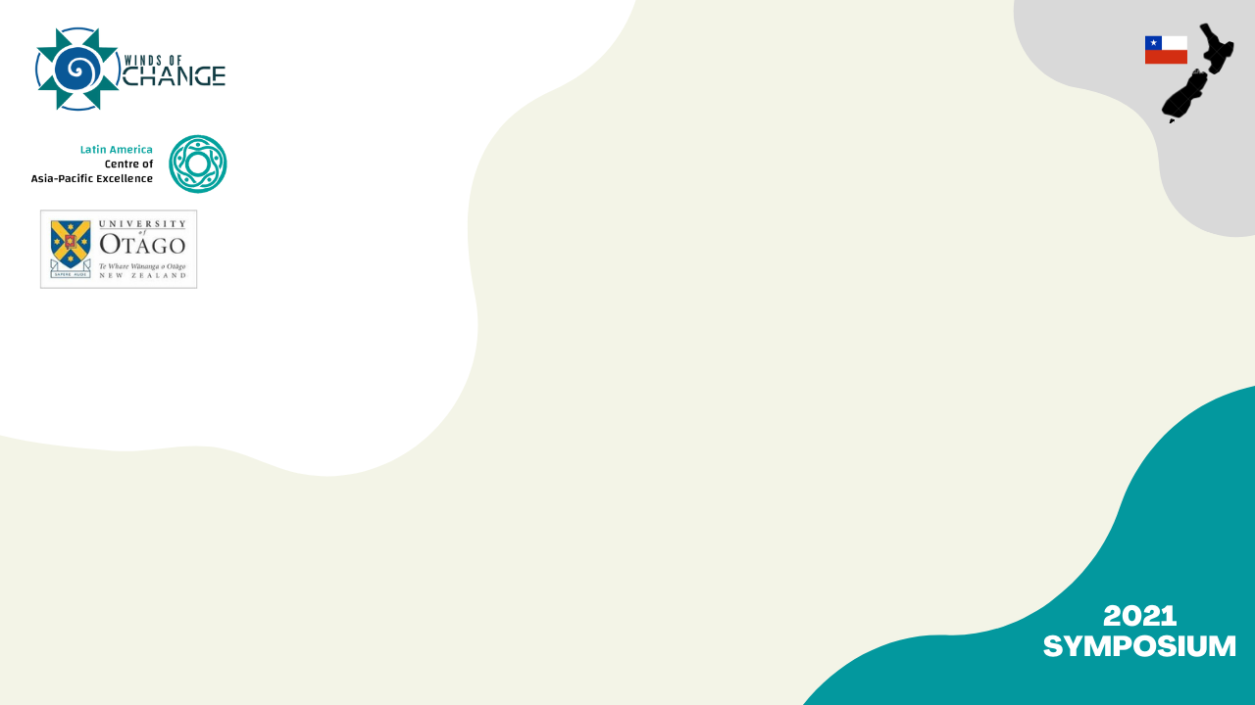
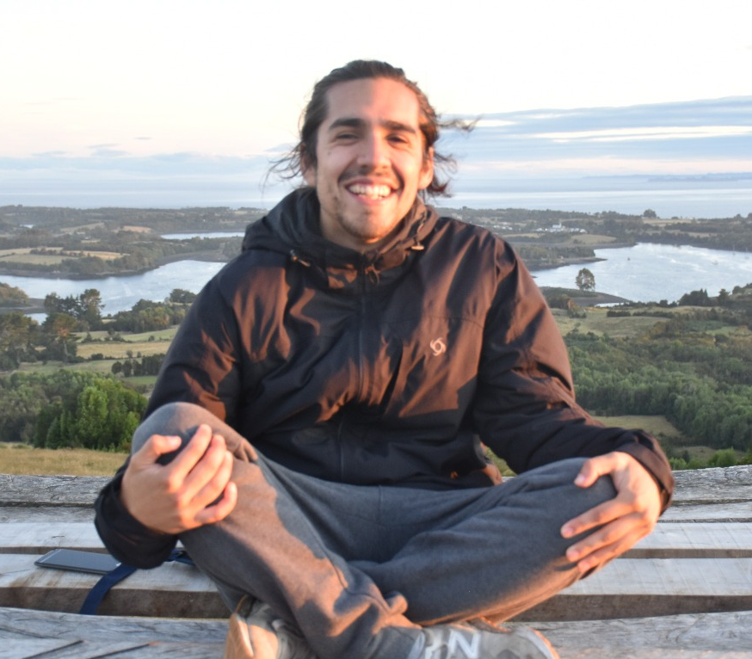
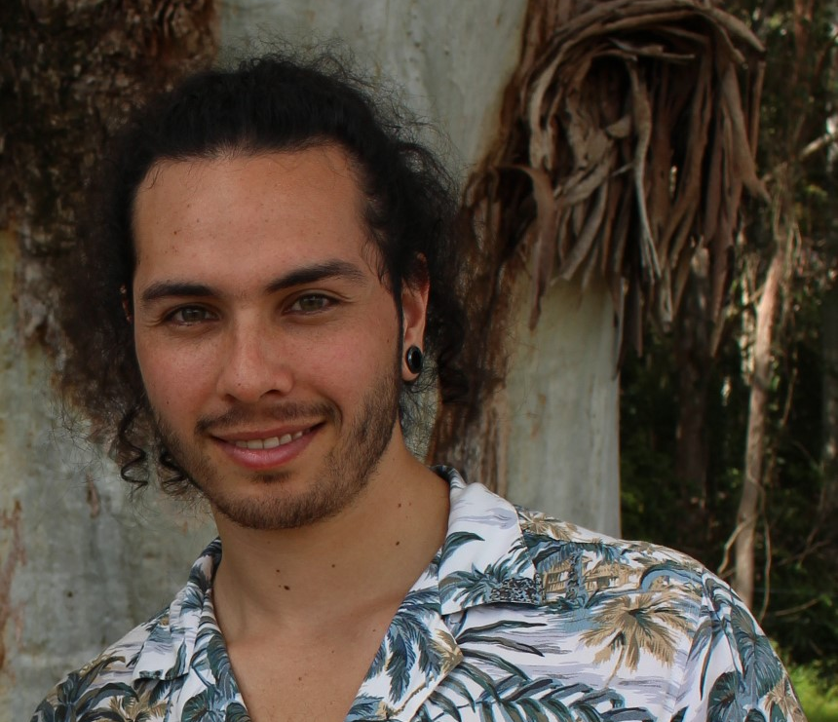
GONZALO CÉSAR CONTRERAS (CHILOÉ)
Bachelor in Environmental Engineering
University of Concepción
Chilean
DIAN MUÑOZ (CHRISTCHURCH)
Bachelor in Science with honours (Biochemistry)
University of Canterbury
Chilean

Slide 3
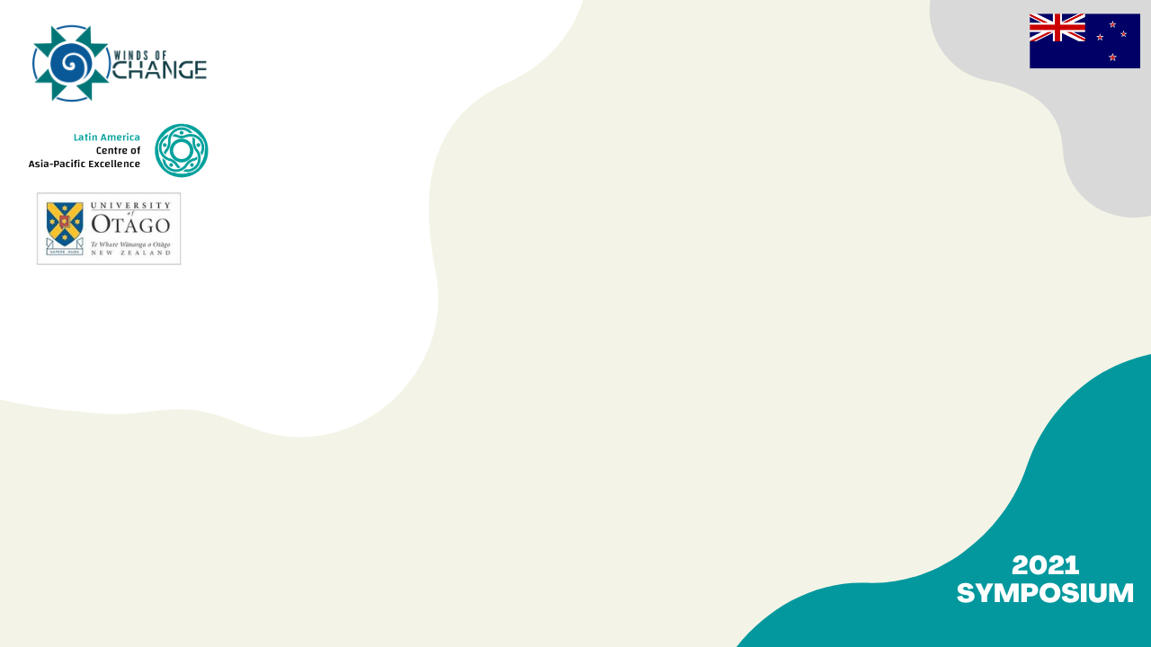
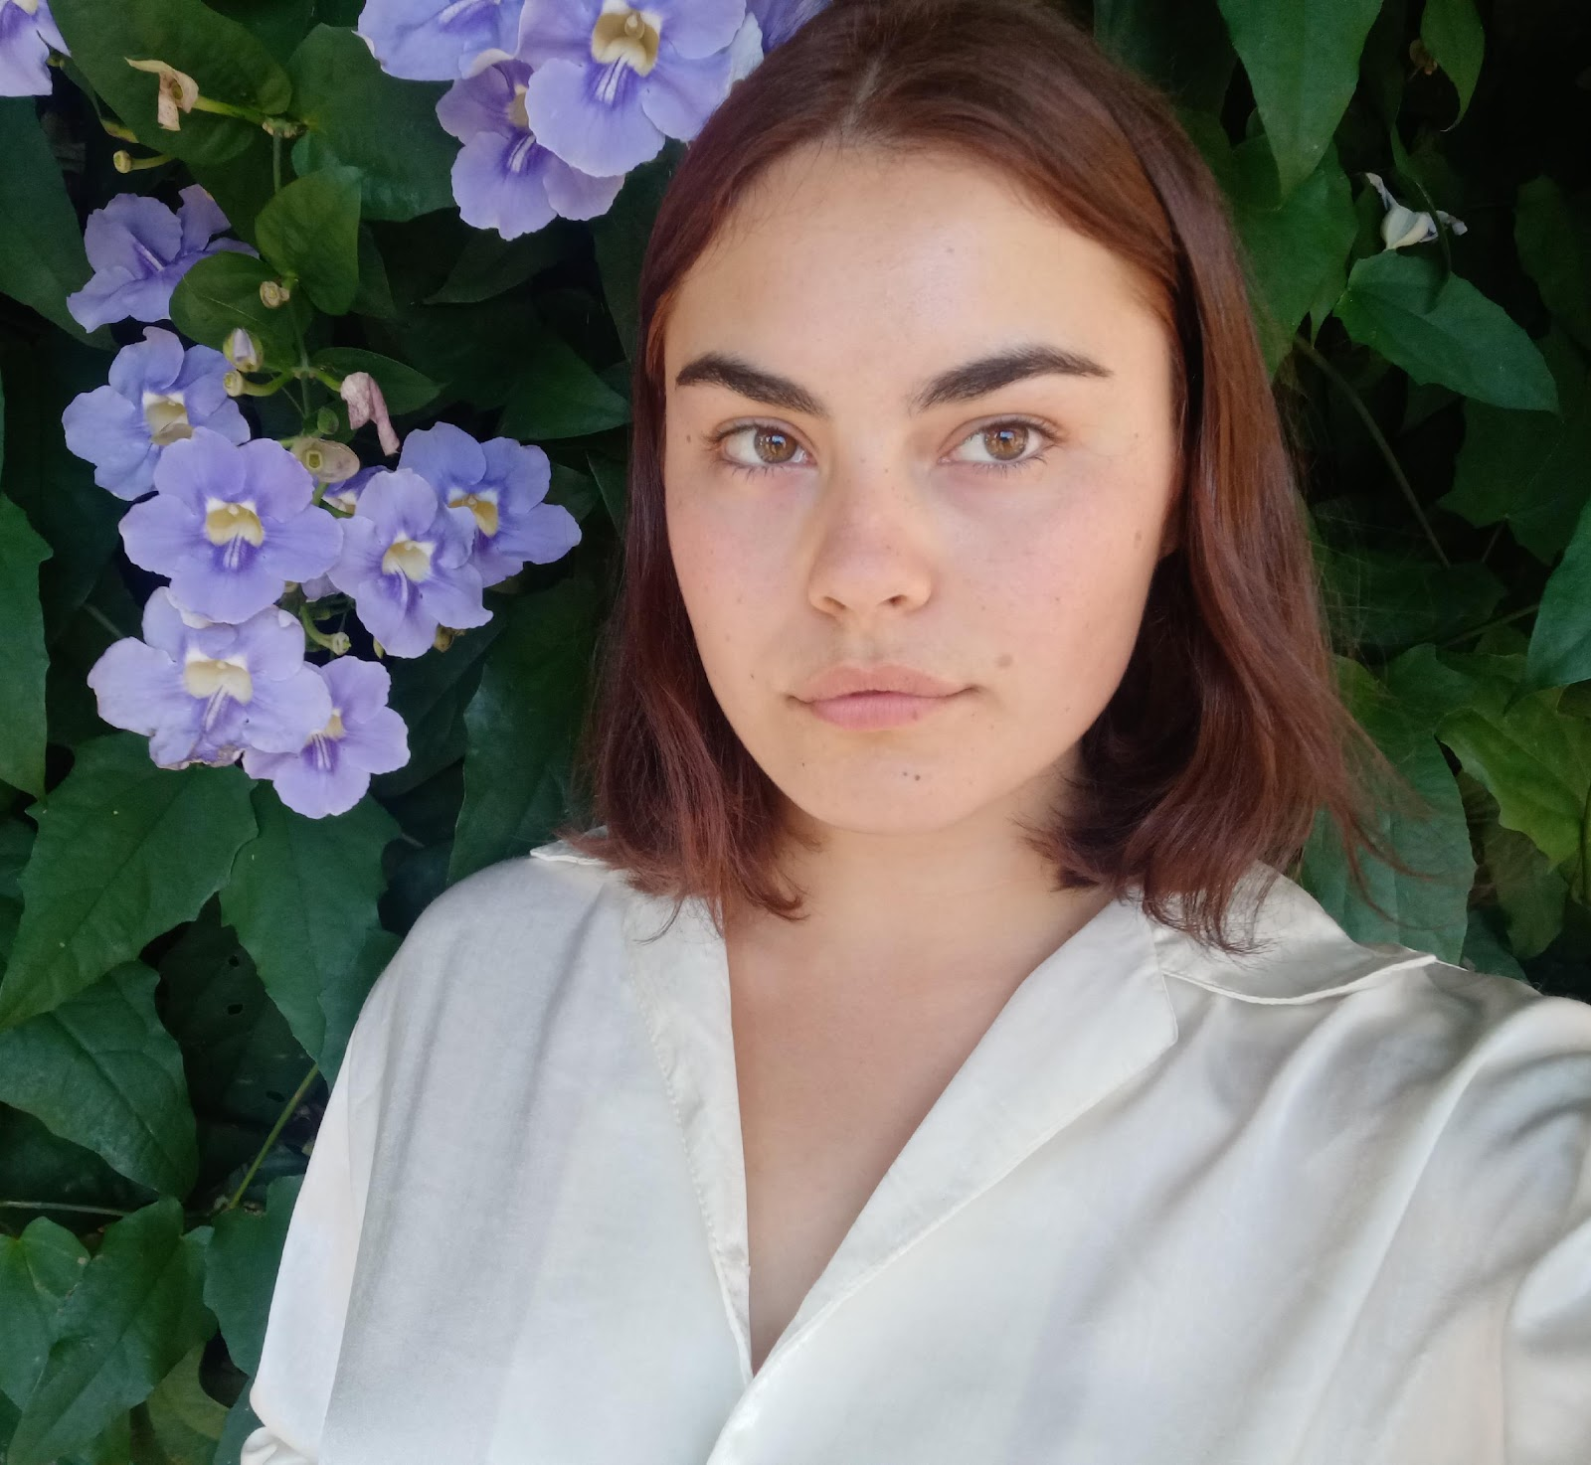
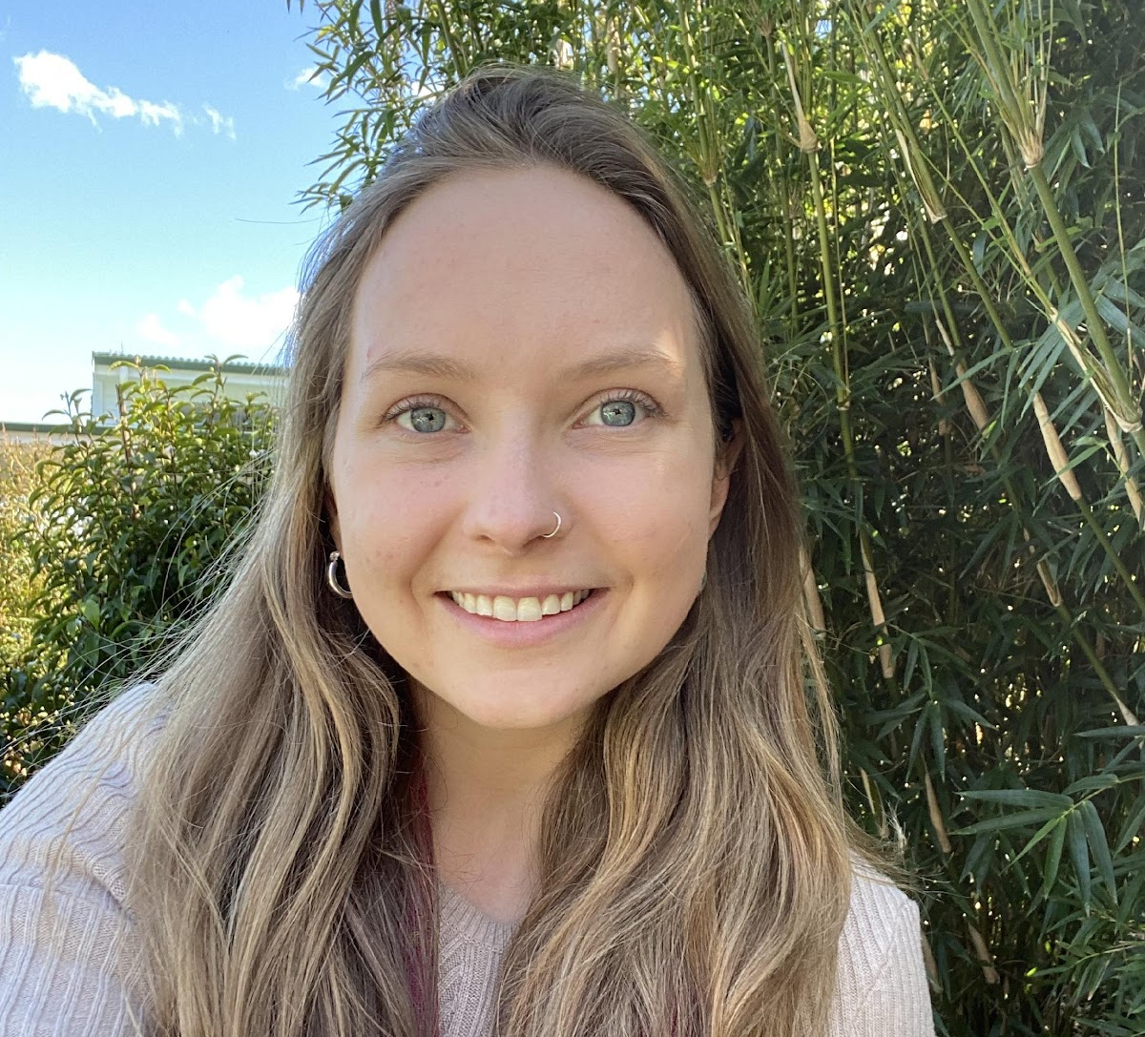
SUMMER WRIGHT (AUCKLAND)
PhD in Food Technology (in progress)
Massey University
New Zealander
OLIVIA MARÍA ADAMSON (HAMILTON)
Masters of Environmental Science (Research) University of Waikato
New Zealander / Argentinean
Notes:
And I am Olivia Adamson, a masters student in environmental sciences at the University of Waikato (until tomorrow actually!). I am half-new Zealander and half-argentinean

Slide 4
WHY FOOD?
Universal
Identity building
Cultural + environmental
Local + global
Rural + urban
Notes:
First of all, why we chose to talk about food:
There’s one thing that every single human has in common, and it is that we need food, and we (in an ideal world) eat every day.
Food is also a huge part of cultures, and builds identities,
In today’s globalised world, food is relevant at both local and global scales— for example a lot of the grapes we get here in NZ come from Chile
And lastly, it involves both rural and urban environments.

Slide 5
8.9 % OF THE GLOBAL POPULATION IS UNDERNOURISHED
SOFI, 2020
OBESITY, CARDIOVASCULAR DISEASE, CANCER DIABETES
Notes:
So naturally, food production and distribution has wide-reaching social implications—
In a world where we produce more than enough food to feed everybody in every country, millions go undernourished (8.9% of the global population according to a 2020 report)— for example 46.9% of the grain produced in the world is destined to feed livestock (Montana, 2018)
And almost paradoxically, obesity is also on the rise everywhere; cardiovascular disease, cancer and diabetes being commonplace, posing a burden on public health systems

Slide 6
20%
16%
OF CHILDREN IN NZ LIVED IN HOUSEHOLDS THAT WERE MODERATELY TO SEVERELY FOOD INSECURE IN 2016
OF CHILEANS SUFFER FROM FOOD INSECURITY (2.9 MILLION PEOPLE)
(SOFI, 2020)
(Ministry of Health, 2019)
THE PANDEMIC MAY ADD BETWEEN 83 AND 132 MILLION PEOPLE TO THE TOTAL NUMBER OF UNDERNOURISHED IN THE WORLD IN 2020 (SOFI, 2020)
Notes:
In New Zealand, it is estimated that 20% of children lived in households that were moderately to severely food insecure in 2016
While 16% of Chileans (2.9 M people) suffer from food insecurity
The pandemic has further highlighted these issues.
The paradox of all this is that we are talking about economies that are largely driven by agriculture.

Slide 8
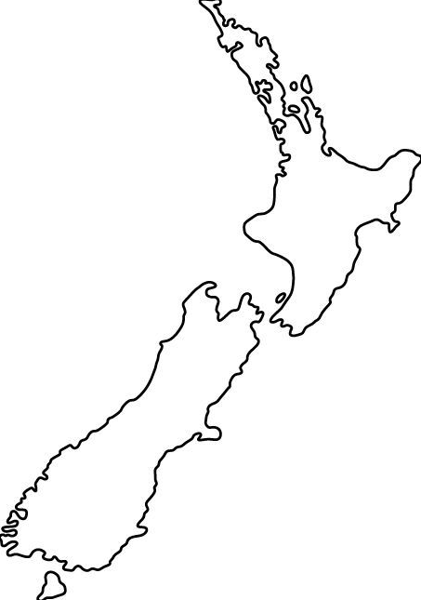
CHILE
AOTEAROA
Agriculture = 6,7% of emissions (MINAGRI, 2019)
66% of evaluated species are threatened (<5% were considered) (Ministerio del medio ambiente, 2019)
Agriculture = 48% of emissions (MFE, 2021)
80% of native NZ species are threatened (MFE, 2019)
46% of lakes larger than 1 hectare (1,758 lakes) are in poor or very poor ecological health (MFE, 2020)
AND climate change is bound to make agriculture more difficult
Notes:
On the other hand agriculture is a major driver of climate change responsible for 24% of global emissions (IPCC< 2014). It also contributes to soil and water degradation and biodiversity loss
And on the flip side, climate change is bound to make agriculture more difficult, with more severe floods, droughts, wildfires and frequency of extreme events.

Slide 9
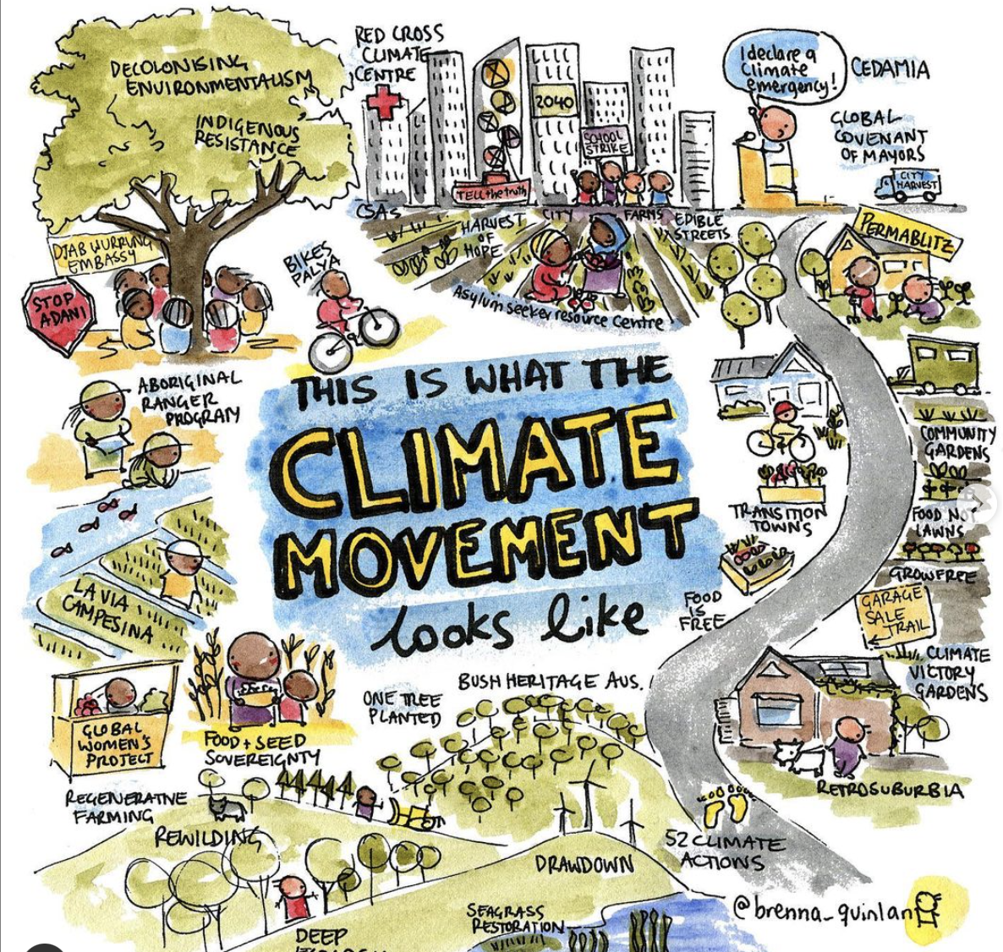
OPPORTUNITY
Notes:
These are big intersectional issues, and the solutions are not always straightforward.
HOWEVER, It is not a knowledge or technological gap that is occurring — we have the tools to improve food systems — it is a gap in equity and environmental protection
Large scale systemic changes are critical— and sometimes, work at that level seems slow, intangible and inaccessible to most people, which leads to a feeling of alienation and disempowerment.
What we wanted to do through this project is to change the narrative from one of doom and gloom to one of opportunity, empowerment and action.
For this, we wanted to highlight the everyday people taking climate action that is not based on “projection” or “plans”— it is immediate action that affects change now. And so we saw the opportunity to spotlight their work and their effort and to galvanise our audience into action— and food is something we engage with everyday, so what more exciting than knowing that what you are putting on your plate is paving the way for a better future for both people and planet to thrive?
And so we decided to make a video that can be distributed in social media and news outlets to raise awareness, educate and inspire

Slide 10
VIDEO

Slide 11
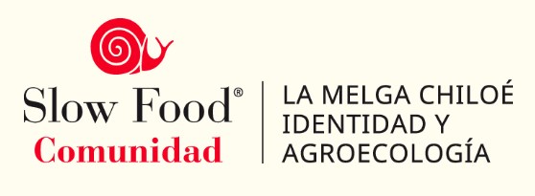
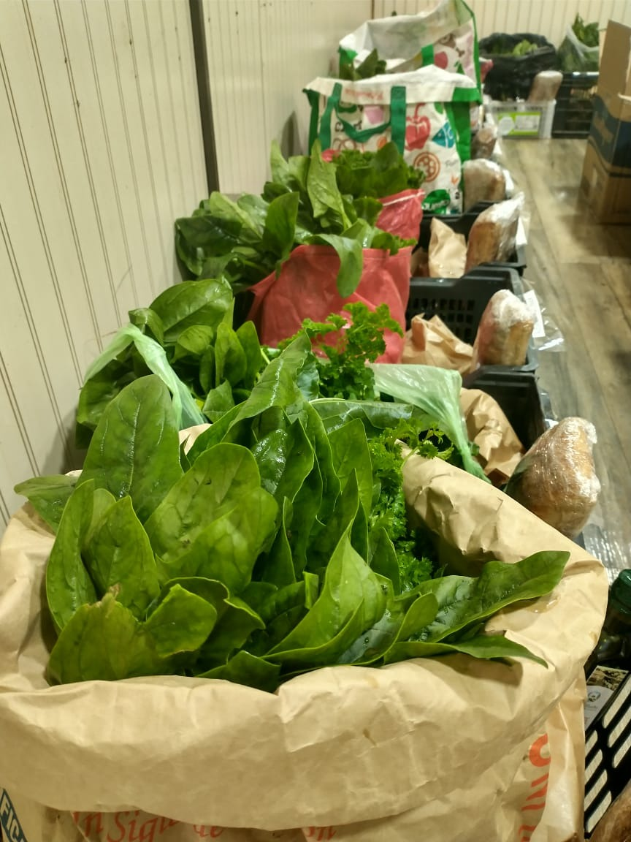
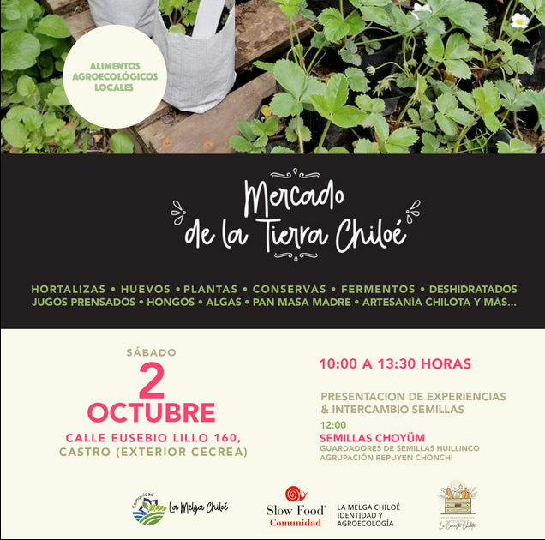
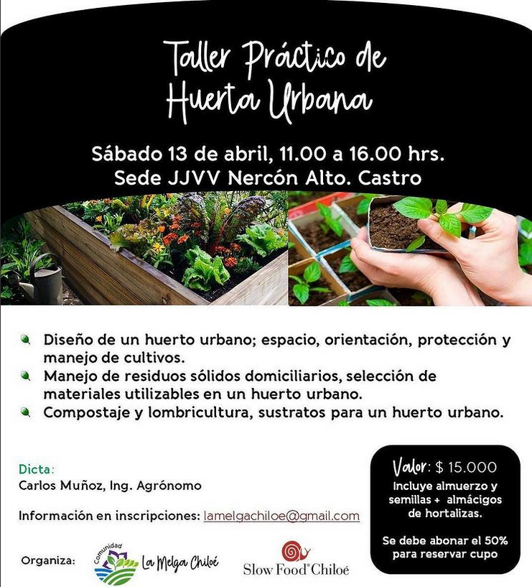
LA MELGA, CHILOÉ
IDENTIDAD Y AGROECOLOGÍA // IDENTITY AND AGROECOLOGY
Canasta alimenticia
Food baskets
Mercado de la Tierra Farmers market
Talleres & educación
Workshops & educational programs

Slide 12
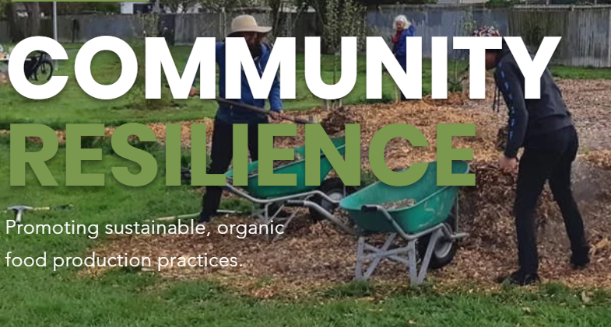
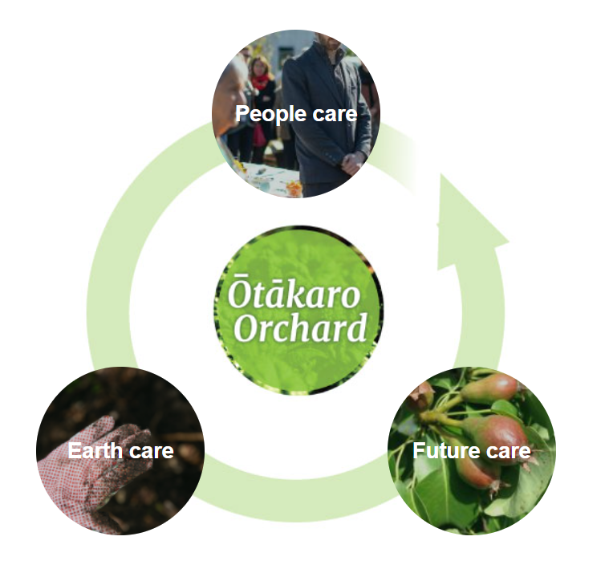
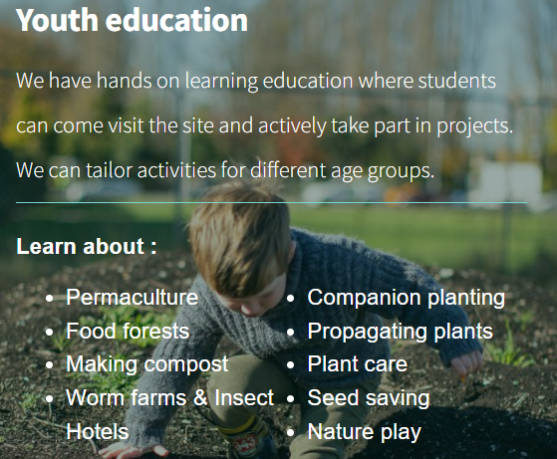
ROIMATA FOOD COMMONS, CHRISTCHURCH, NZ
Notes:
An org that fosters community values around food, but not only to make people more adaptable to climate events,
but it also builds psychological resilience because people feel in control the most basic thing they need to survive.
People that come to roimata can connect with nature and get what they need to eat, and through, they learn the important ways we can make a difference.
If we take care of the earth, we are taking care of our future and ourselves at the same time.

Slide 13
FINAL THOUGHTS…
Notes:
Its really easy to feel alone in this and re-imagining our food systems is a huge challenge, but also massive opportunity that every person can engage with.
Change needs to happen at all levels.
we need to see our governments and policy makers stepping up to the challenge..
And these communities are doing great stuff and we can be inspired by them, but the responsibility should not be on communities or individuals.
We hope we’ve given you some ideas of where to start, and you feel empowered to transform our food systems…
Thanks for listening

Slide 14
REFERENCES
SOFI: State of Food Security. 2020. Food and Agriculture Organisation of the United Nations. Full report at: https://www.fao.org/3/ca9692en/online/ca9692en.html
Montana, Q. 2018. The Energy Yield of Global Crops 1961-2016. Theses and Dissertations. 2837. http://scholarworks.uark.edu/etd/2837
Ministry of health. 2019. Household Food Insecurity among Children: New Zealand Health Survey. Full report at: https://www.health.govt.nz/publication/household-food-insecurity-among-children-new-zealand-health-survey
Ministry for the environment. 2019. Climate Change Projections for New Zealand: Atmosphere Projections Based on Simulations from the IPCC Fifth Assessment, 2nd Edition.
Ministry for the environment. 2020. Our Freshwater. Full report at: https://environment.govt.nz/publications/our-freshwater-2020/
Ministry for the environment. 2021. Our Land. Full report at: https://environment.govt.nz/publications/our-land-2021/ou
Our world in data. 2019. Food production is responsible for one-quarter of the world’s greenhouse gas emissions. Retrieved from: https://ourworldindata.org/food-ghg-emissions
MINAGRI (2019). Chilean agriculture overview. Office of Agricultural Studies and Policies (ODEPA). https://www.odepa.gob.cl/wp-content/uploads/2019/09/panorama2019Final.pdf
Ministerio del Medio Ambiente, 2019. Sexto Informe Nacional de Biodiversidad de Chile ante el Convenio sobre la Biodiversidad Biológica (CDB). Chile, 220 pp. https://mma.gob.cl/wp-content/uploads/2020/01/6NR_FINAL_ALTA-web.pdf

