Slide 1
Industry Insights
Stu Cordelle
Shotover Canyon Swing

Slide 2
Highlights ♦ Importance of cultural education and training for staff ♦ Being flexible to adapt to visitors from different cultures ♦ Effective communication to ensure customer satisfaction
My name is Stu Cordelle and I'm the General Manager for Shotover Canyon Swing.
We are seeing a much stronger engagement from the South American markets, the Asian markets.
It’s really important to understand people are from different cultures, how they might react to different things.
Cultural training really helps the staff.
What we are trying to do is educate our team. Make sure they are aware of what they need to do when talking to these people, explaining what we are doing.
If we have someone from South East Asian countries that has Muslim background, particularly females, not being comfortable being touched by male, we can have our female staff come down and help out with that.
We also need to ensure that our staff make it clear what we are doing is ensuring that people are wearing headwear that they need to keep on for religious reasons. That actually OK, as long as it’s tight and don’t fall off, we can do that.
We can also fit a large helmet so that it fits over the garment.

Slide 3
Communication is essential. We need to ensure that people understand what we are saying. So we talk slowly.
We are also able to provide them with pictorial information to understand that as well.
Pictures are important and easiest way to show people our safety requirements and what we do to keep them safe.
Don’t be afraid about of finding out about different cultures. If you find out about what they want, you can provide exactly what they require.
I don’t think it takes away from the Kiwi feel and vibe of what we do. It just helps them feel safer. And put some more risk at ease.
And when they do that they going to have lot more fun.

Slide 4
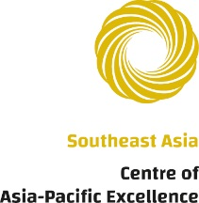
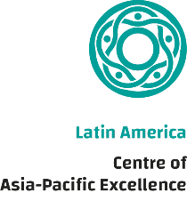
Discover more
Videos
Quizzes
Guides
www.CultureReady.co.nz
Produced by Department of Tourism and Department of Marketing © 2020

